Slide 1
Coordinate Geometry
Gayan Perera

Slide 2
Outline
Equation of a straight line
Parallel lines
Perpendicular lines
Distance between two points
Mid point between two points
Perpendicular Distance from a point to a line
Equation of a circle
Polar Coordinates
Tangent to a circle

Slide 3
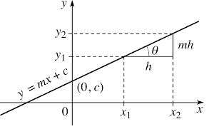
Linear Functions
A Linear Function is a function of the form: where m and c are real numbers and m is the slope and c is the intercept.
The domain and range of a linear function are all real numbers.

Slide 4

Question
Q) Identify the slope and the intercept of the following:
1. $5x−6y=−12$
2. $x−6y=−1$1
3. $y−5x=20$
4. $−3x=−0.5y+7$
5. $\frac{x+3}{2y−5}=−4$

Slide 5
The slope m is also called as the gradient / Average rate of change of the line.
The average rate of change of a linear function is defined by
The angle theta is measured counter clockwise from the positive x-axis.

Slide 6
When f(x) = -3x+4
Slope: m = -3
Intercept: c = 4
The average rate of change is the constant m = -3
Since m =-3 is negative, the graph is slanted downwards. Thus the function is decreasing

Slide 7
When f(x) = 3
f(x)=0x + 3
Slope: m = 0
Intercept: c = 3
The average rate of change is 0
The function is constant neither increasing or decreasing

Slide 8
Plotting a graph from the line equation
Methods
Plot the line by identifying x and y intercepts
Plot the line by identifying the slope and the intercept from the given equation
Note: If the slope is not given, at least two points are required to plot a line.

Slide 9
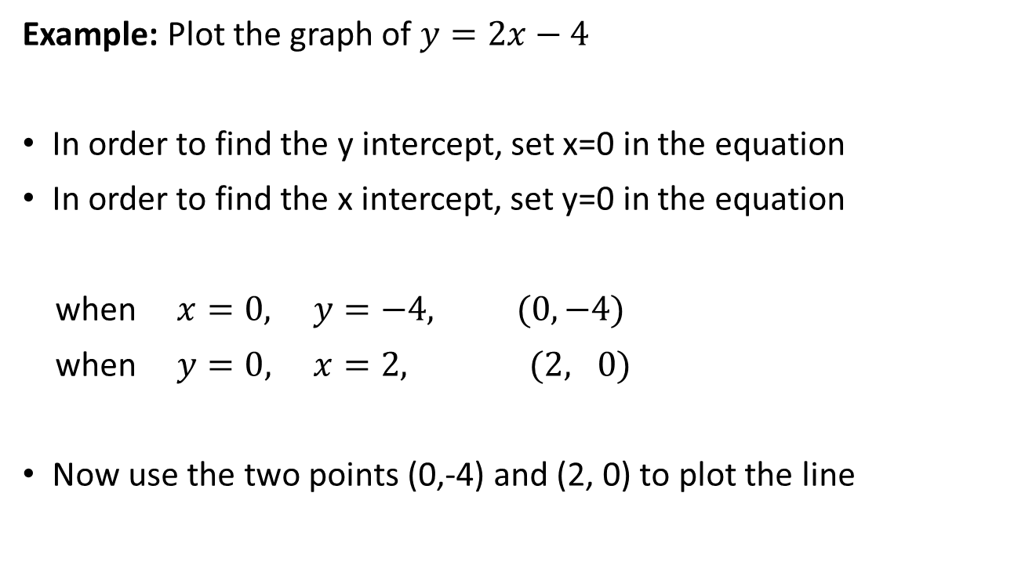
Plotting a line by identifying x and y intercepts
Example: Plot the graph of $y=2x−4$
In order to find the y intercept, set x=0 in the equation
In order to find the x intercept, set y=0 in the equation
when $x=0, y=−4, (0,−4)$
when $y=0, x=2, (2, 0)$
Now use the two points (0,-4) and (2, 0) to plot the line

Slide 10
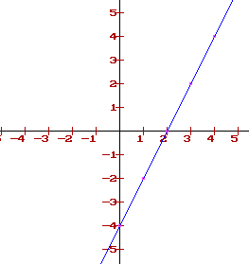

Plotting a line by identifying x and y intercepts
Plot the graph of $y=2x−4$
(2,0)
(0,-4)

Slide 11
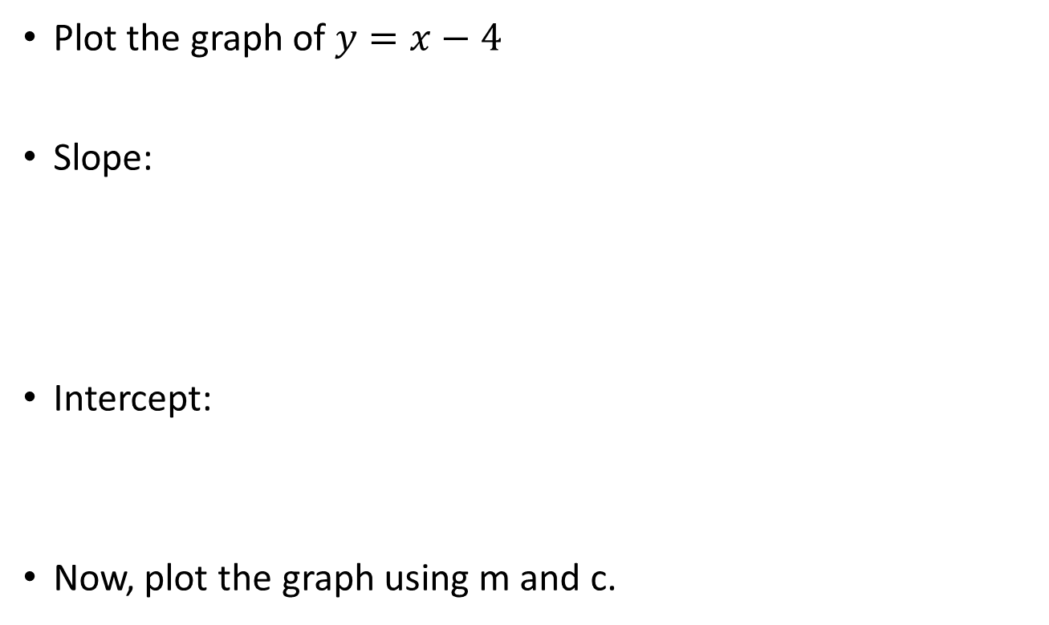
Plotting a line by identifying the slope and the intercept
Plot the graph of $y=x−4$
Slope:
Intercept:
Now, plot the graph using m and c.

Slide 12
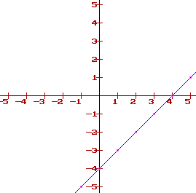

Plotting a line by identifying the slope and the intercept
Plot the graph of $y=x−4$
(45º)

Slide 13
Draw rough sketches of the following graphs.
i)
ii)
iii)
iv)
v)
vi)

Slide 14

Qs-
Exercise:
Sketch $y=−2x+7$ using x and y intercepts and plot the same line identifying the slope and the intercept.

Slide 15
Identify whether the following data fits a linear function or not
Q1. Q3.
Q2. Q4.
NOTE: Slope of a linear function is a constant regardless of what points are used to calculate it.
x | y=f(x)
-1 | -9
0 | -7
1 | -5
X | y=f(x)
-1 | 5
0 | 5
1 | 5
x | y=f(x)
-1 | -6
0 | -7
1 | -6
X | y=f(x)
-1 | -4
0 | -1
1 | 6

Slide 16
Equation of a line
Finding the line equation when the slope and a point on the line is given:
Lets consider the slope to be ‘m’ and the point A (x₁, y₁) to be on the line. Then, the line equation is given by:
Example:
Q) Find the equation of a line that goes through the point (3, 4 ) with a slope =-2.

Slide 17
Equation of a line
b) Finding the line equation when two points are known.
Suppose A (x₁, y₁) and B (x₂, y₂) are on the line. Then, the line equation is given by:
Example:
Q) Find the equation of a line through points (3, 4) and (-1, 6).

Slide 18
Parallel lines
Parallel lines have the same slope.
Q) Graph a line parallel to the given line L1 and through point (0, -1):
Slope of the parallel line: 3/5
Line equation:
Line: L1

Slide 19
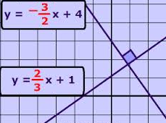
Perpendicular lines
Perpendicular lines have the opposite reciprocal slopes
Suppose the slope of a line L₁ is m₁ and the line drawn perpendicular to L₁ has a slope of m₂. Then, the following relationship holds:
For E.g.
Example:
Find the equation of a line(L₁) through points (3, 4) and (-4, -6). Now write the equation of the line perpendicular to L₁ containing point (2,3)

Slide 20
Summary: Parallel and Perpendicular lines
Consider two lines L₁ and L₂ with slopes m₁ and m₂ .
a) If L₁ is parallel to L₂
b) If L₁ is perpendicular to L₂

Slide 21

Identify the following pairs of lines are parallel, perpendicular or not
1. $x−y+1=0$ 4. $−3x+4y+1=0$
$x+y−6=0$ $4x+3y−6=0$
2. $−51x+23y+40=0$ 5. $−3x+4y+1=0$
$−51 x+23y−19=0 4x−3y−6=0$
3. $ax+by+c=0$ 6. $ax+by+c=0$
$ax+by−c=0$ $bx−ay−c=0$
Notes:
Perpendicular
Parallel
Parallel
Perpendicular
Neither parallel nor perpendicular
Perpendicular

Slide 22
Distance between two points
The distance between point A (x₁,y₁) and point B(x₂,y₂) is given by the following expression.
Proof: Use Pythagoras theorem to prove.
Q) Find the distance between points (-1,-2) and (3,4).

Slide 23
Mid Point between two points P & Q
Y-axis
Q(x₂,y₂)
y₂
y₁
P(x₁,y₁)
X-axis
0
x₁
x₂
Q) Find the mid point between (-1,-2) and (3,4)

Slide 24
Identifying the intersection point of two intersecting lines
Consider L₁ to be a line with the line equation y=m₁x+c₁ and L₂ to be another line with the line equation y=m₂x+c₂.
If the lines L₁ and L₂ intersect, the intersecting point could be found by solving the line equations simultaneously.
Solve:
L₁→ y=m₁x+c₁
L₂→ y=m₂x+c₂

Slide 25

Find the intersection point of the following lines:
1. $x+y=5$
$x−y=2$
2. $x−y=−1$
$3x+5y=−1$
3. $4x+7y=20$
$21x−13y=21$

Slide 26
Identifying whether a given point is on a defined line
Consider L₁ to be a line with the line equation y=mx+c.
If a point (x₁,y₁) is on the line L₁:
The point (x₁,y₁) satisfies the line equation.

Slide 27
Q: Check whether the following points are on the given lines
1. A(2,3) B(-2,-3) C(1,4) D(3,2)
2. A(1,1) B(-1,-2) C(2/3,0) D(0,0.5)
3. A(1,-1) B(-2,1) C(2,-1) D(5,-3)
4. A(1.5,2) B(-2,4) C(2,2) D(7,-1)
5. A(2,1) B(-2,2) C(-1.5,2) D(-5,3)

Slide 28
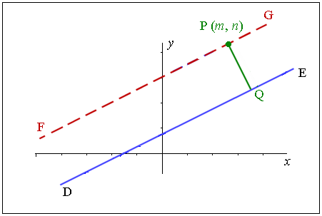
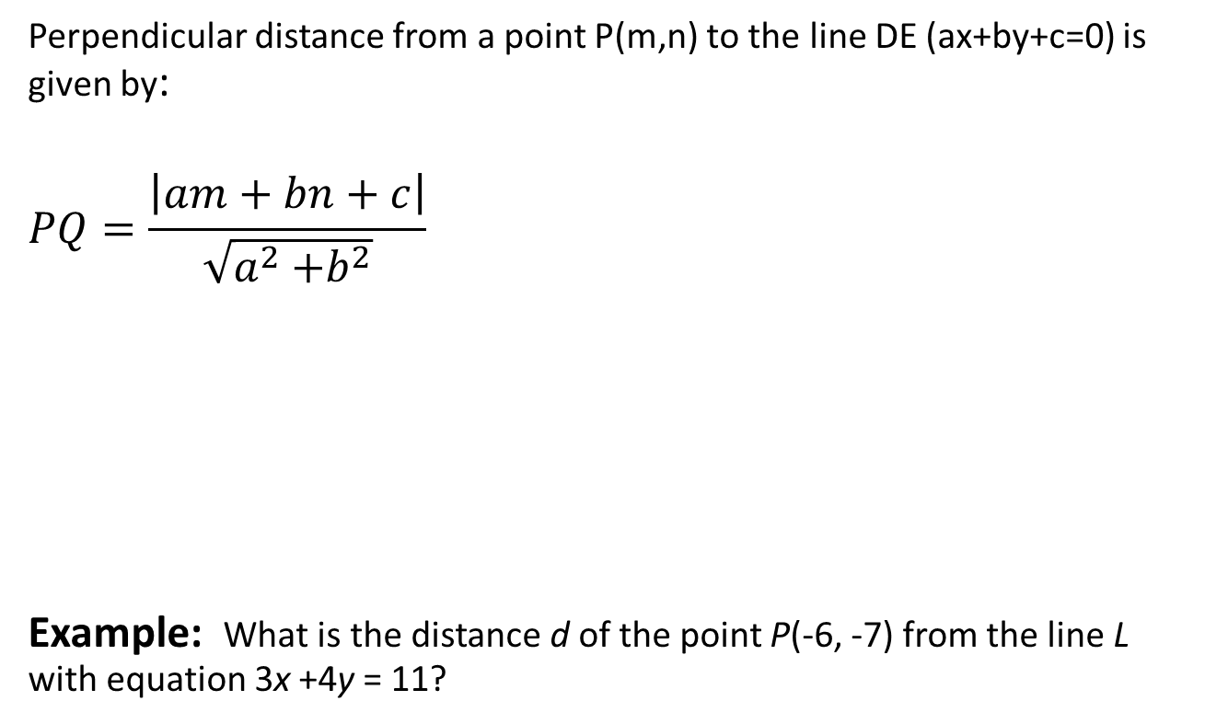
Perpendicular distance from a point to a line
Perpendicular distance from a point P(m,n) to the line DE (ax+by+c=0) is given by:
$$PQ=\frac{\left|am+bn+c\right|}{\sqrt{a^{2}{+b}^{2}}}$$
Example: What is the distance d of the point P(-6, -7) from the line L with equation 3x +4y = 11?
Notes:
57/5

Slide 29
Circles

Slide 30
Definitions
Circle: The set of all points that are equidistant from a fixed point.
Center: the fixed point
Radius: a segment whose endpoints are the center and a point on the circle

Slide 31
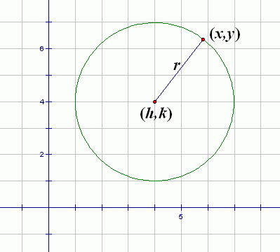
Standard equation of a circle
If the circle is at the origin
x ² + y ² = r ² r is the radius
If the circle is not at the origin
The center is at (a, b)
(a, b)

Slide 32
Writing the equation of a circle given the center and the radius
1. Write the equation of a circle given the center C(-5,0) and radius 5
2. Write the equation of a circle given the center C(2,3) and radius 5

Slide 33
Writing the equation of a circle given the center and a point on the circle
1. Write the equation of a circle given the center C(-3,0) and the point A(0,-4)
2. Write the equation of a circle given the center C(2,-3) and the point A(8,5)

Slide 34
Checking whether a given point is out, in or on the circle
(x – 13)² + (y – 6)² = 5²
Tell if the point (5, 6) is inside or outside the circle.
Check if (5 -13)² + (6 – 6)² is <, >, or = to 5² ( - 8)² + 0² = 64 > 25
Greater than 5² indicates the point is outside the circle.
Less than 5² indicates the point is inside the circle.
Equal to 5² indicates the point is on the circle.

Slide 35
Checking whether a given point is out, in or on the circle
(x – 13)² + (y – 6)² = 5²
Tell if the following points are inside, outside or on the circle.
A (5, 6)
B (14,8)
C (20, 9)
D (16, 2)

Slide 36
General equation of a circle
When g, f, c are constants, the general equation of a circle is given by:
Center:
Radius:

Slide 37
Q: Find the center and the radius of the following
1.
2.
3.

Slide 38
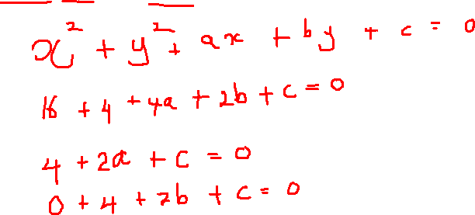
Finding the equation of a circle given 3 points on the circle
1. Find the equation of the circle that goes through points (0,0), (1,0) and (0,1)
2. Find the equation of the circle that goes through points (4,2), (2,0) and (0,2)

Slide 39
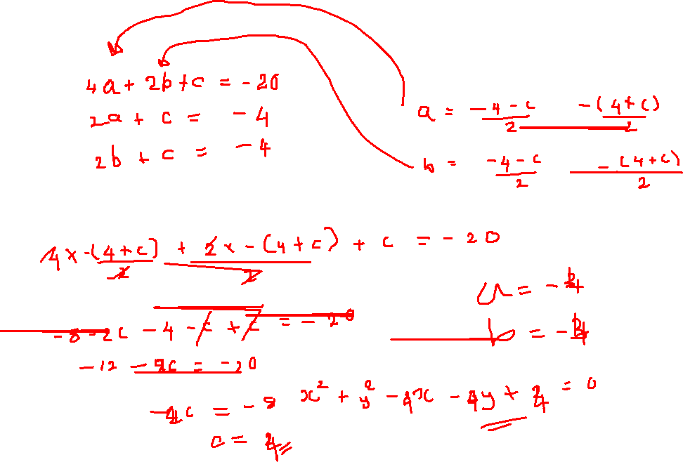

Slide 40
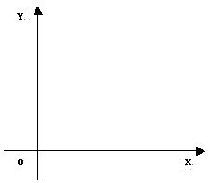
Cartesian Coordinates
A coordinate system represents a point in the plane by an ordered pair of numbers called coordinates.
Usually, we use Cartesian coordinates, which are directed distances from two perpendicular axes.

Slide 41
Polar Coordinates
We choose a point in the plane that is called the pole (or origin) and is labeled O.
Then, we draw a ray (half-line) starting at O called the polar axis. This axis is usually drawn horizontally to the right corresponding to the positive x-axis in Cartesian coordinates.

Slide 42
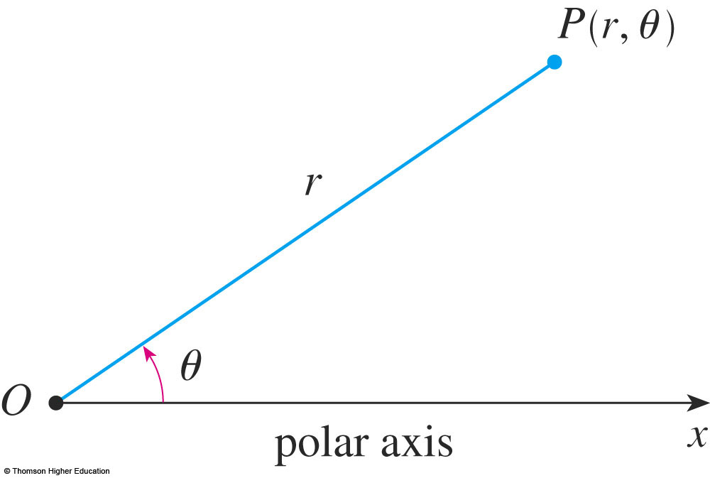
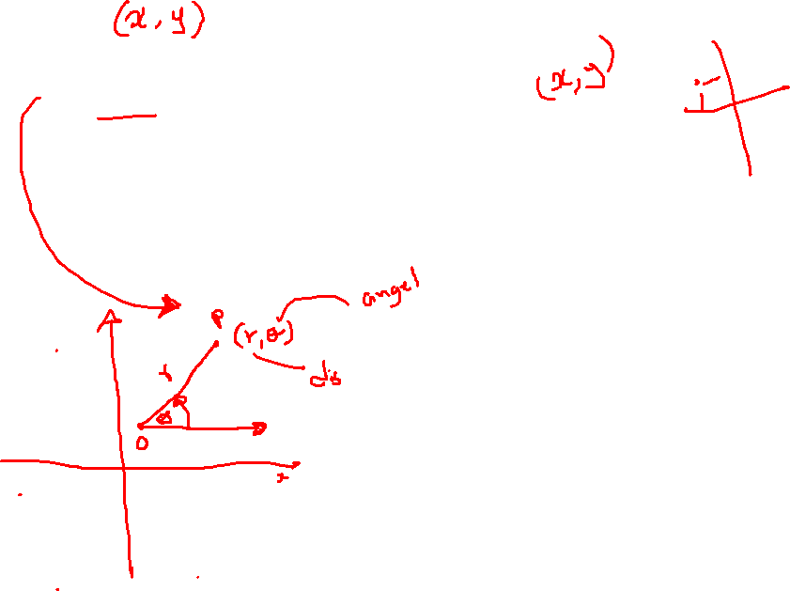
Polar Coordinates
If P is any other point in the plane, let:
r be the distance from O to P.
θ be the angle (usually measured in radians) between the polar axis and the line OP.

Slide 43
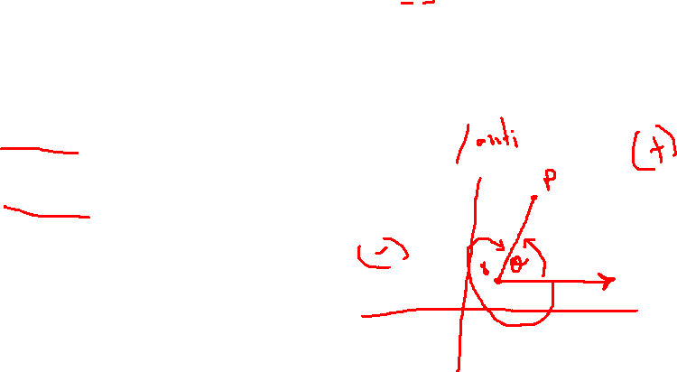
Polar Coordinates
P is represented by the ordered pair (r, θ).
r, θ are called polar coordinates of P.
We use the convention that an angle is:
Positive—if measured in the counterclockwise direction from the polar axis.
Negative—if measured in the clockwise direction from the polar axis.

Slide 44
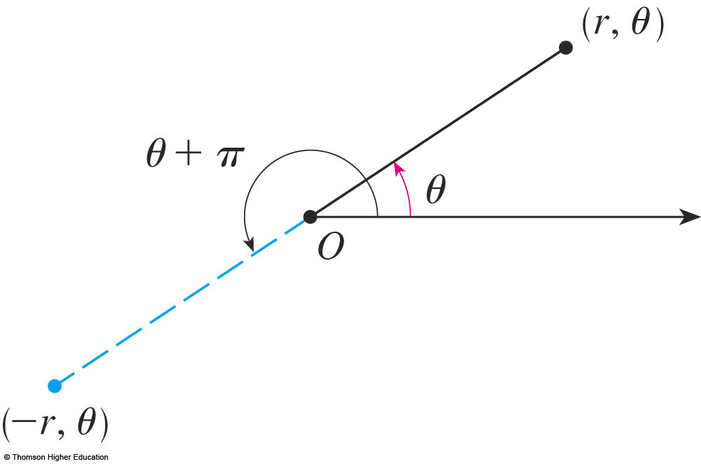
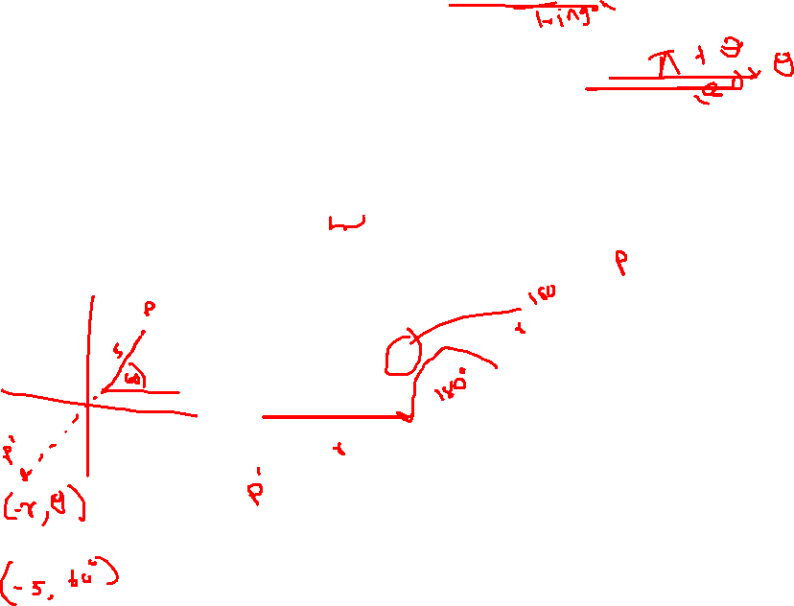
Polar Coordinates
As shown below, the points (–r, θ) and (r, θ) lie on the same line through O and at the same distance | r | from O, but on opposite sides of O.

Slide 45
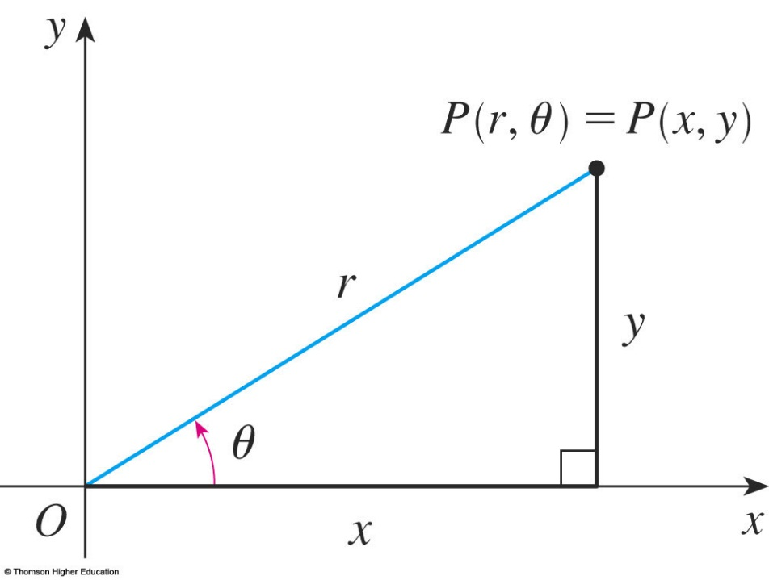
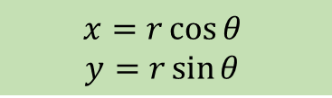
Polar and Cartesian coordinates
The connection between polar and Cartesian coordinates can be seen here.
The pole corresponds to the origin.
The polar axis coincides with the positive x-axis.
$$x=r\cos{θ }$$
$$y=r\sin{θ }$$

Slide 46
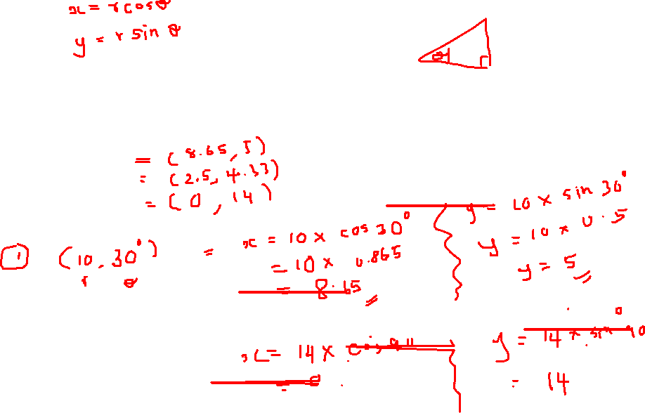
SHORT BREAK 10.55 – 11.05
Find the Cartesian coordinates of following polar coordinates
(10,30)
(5,60)
(14.90)

Slide 47
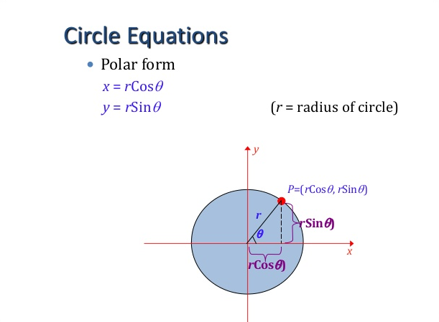
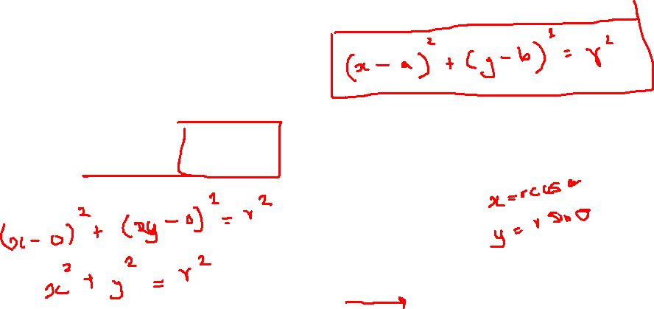
Equation of a Circle in Polar Coordinates

Slide 48
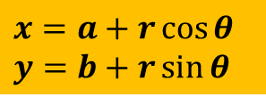

General Equation of a Circle in Polar Coordinates
General Equation is given by:
$$x=a+r\cos{θ}$$
$$y=b+r\sin{θ}$$
(x, y)
$$θ$$
(a, b)

Slide 49
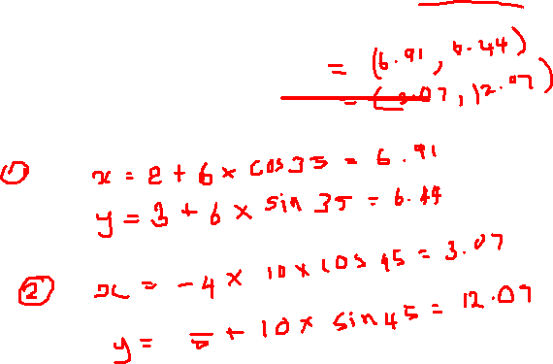
Find the Cartesian points of following polar coordinates with center coordinates
(6,35) -- center(2,3)
(10,45) -- center(-4,5)

Slide 50


$$x=a+r\cos{θ}$$
$$y=b+r\sin{θ}$$
Q) Find 3 points on the circle defined by:
$x^{2}+y^{2}−8x−6y+21=0$

Slide 51
Thank you

